Slide 1
Agile Development

Slide 2
There is no one way
No perfect model exists for software development
  Too many challenges
There are a wide range of ideas on best practice
  All are designed to address the challenges
Any model beats no model
H. L. Mencken:
“For every complex problem there is a solution that is simple, neat and wrong.”

Slide 3
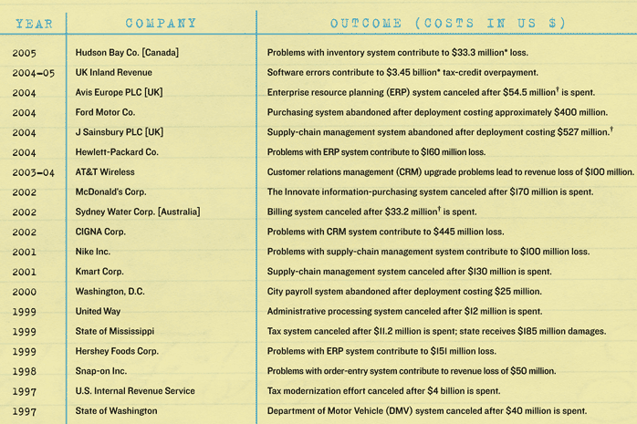
Software Fails
60+ % percent of IT projects fail to meet their objectives, run significantly late or cost far more than planned
http://www.galorath.com/wp/software-project-failure-costs-billions-better-estimation-planning-can-help.php

Slide 4
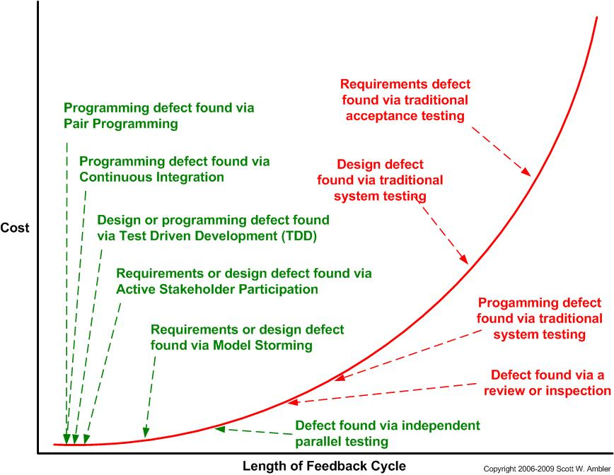
Why do they fail?
Poor planning
  Unclear goals
  Insufficient design
Problems appear at end of project where they are more costly

Slide 5
Early approach to software
Have idea
Write code
Test code
Fix code
Goto 2

Slide 6
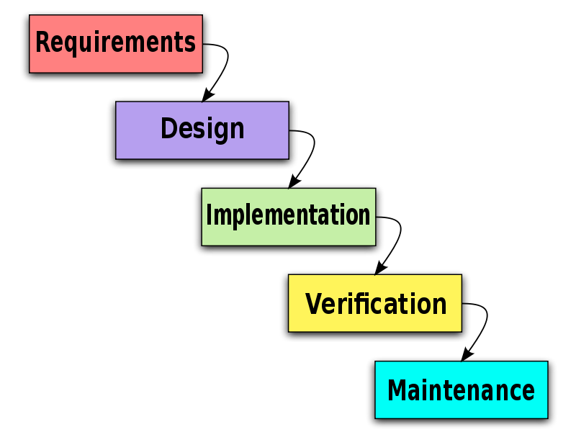
Waterfall
Adopted from mechanical & civil engineering
Provide structure to process
  Well defined phases with products

Slide 7
Waterfall
Dangerous assumptions
  Requirements for a new system can be accurately
  specified in advance
  Detailed design can be done for possibly unproven technologies

Slide 8
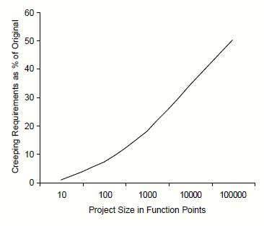
Changing Requirements
Why?
  Users don't understand system until they use it
  Changing market demands
  Because we can – it is SOFTware
Real size projects
experience 25-50%
requirement creep
Notes:
Kruchten, Philippe. The Rational Unified Process—An Introduction, 2nd ed. Reading, MA:
Addison-Wesley (2000).

Slide 9
Poor Design
Who could build a toaster?
  You
  An electrician?
  Someone who had designed a coffee machine
  Someone who had designed and built a coffee machine?
  Someone who had designed and built another toaster?

Slide 10
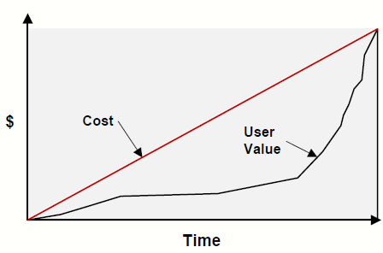
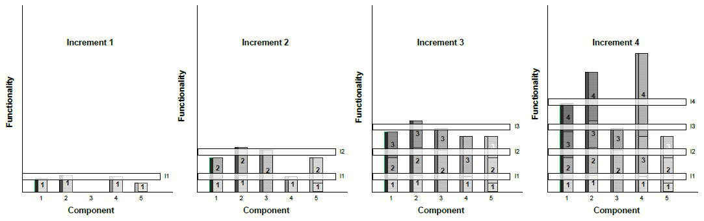
Waterfall Central Problem
If we can not perfectly understand requirements and can not perfectly design a system we will have problems
  Those problems will be found late in development
Value is delivered late in process

Slide 11
Agile Manifesto
We are uncovering better ways of developing
software by doing it and helping others do it.
Through this work we have come to value:
  Individuals and interactions over processes and tools
  Working software over comprehensive documentation
  Customer collaboration over contract negotiation
  Responding to change over following a plan
That is, while there is value in the items on
the right, we value the items on the left more.

Slide 12
So what is it?
Agile :
An iterative and incremental (evolutionary) approach to software development which is performed in a highly collaborative manner by self-organizing teams within an effective governance framework with “just enough” ceremony that produces high quality software in a cost effective and timely manner which meets the changing needs of its stakeholders.
It focuses on early delivery of business value. That involves early and regular delivery of working software, a focus on team communications, and close interaction with the users.

Slide 13
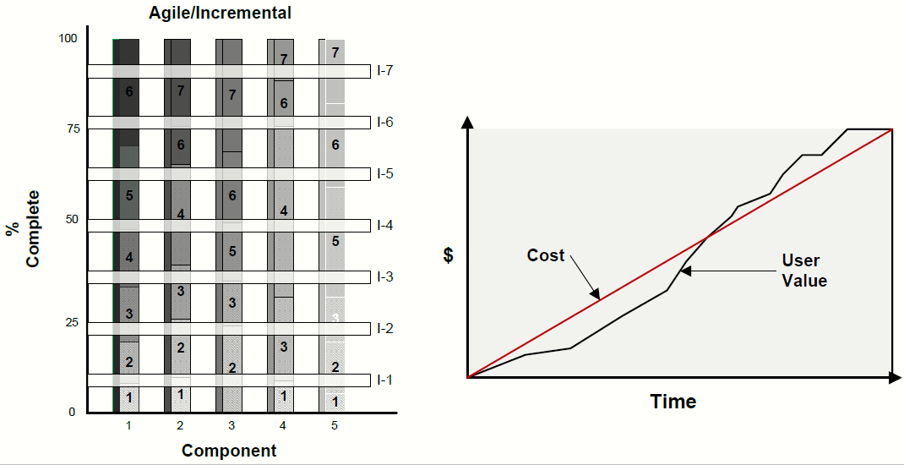
Goal
Continuously produce useable software
Notes:
http://www.sei.cmu.edu/reports/10tn002.pdf

Slide 14
How it works
Software is built incrementally
  Iterations every week-month
  Most important features first
Planning is a continuous process
Decisions made at the last responsible moment
Client continuously involved

Slide 15
What it is not
Agile is NOT
  A lack of planning
  Less work
  A set of rules
  A way to run projects without management
  A way to work faster
  Magic

Slide 16
Flavors of Agile
Agile is a philosophy
Implementations:
  XP – developer practice focused
  Scrum – agile project management
  Lean – adopted from lean manufacturing
  Kanban – continuous process
  Crystal (family)
  RUP (family)

Slide 17
How to Agile
Adopted from:
The Agile Samurai – How Agile Masters Deliver Great Software
http://www.amazon.com/Agile-Samurai-Software-Pragmatic-Programmers/product-reviews/1934356581/ref=dp_top_cm_cr_acr_txt?ie=UTF8&showViewpoints=1
Big ideas:
  Understand the product
  User stories drive development
    Product owner assigns business value
    Developers assign cost
    Fleshed out as needed
  Develop in iterations
  Nothing is done until it is done

Slide 18
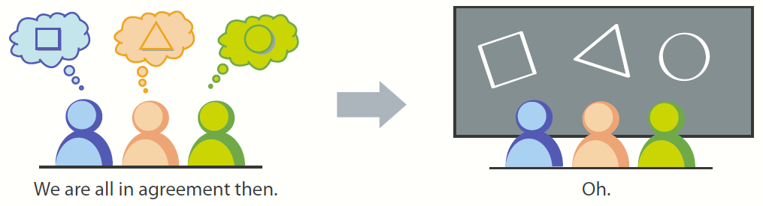
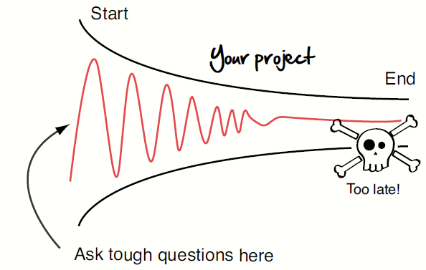
Understanding the project
Build consensus – don't assume it
Identify the potential
problems early

Slide 19
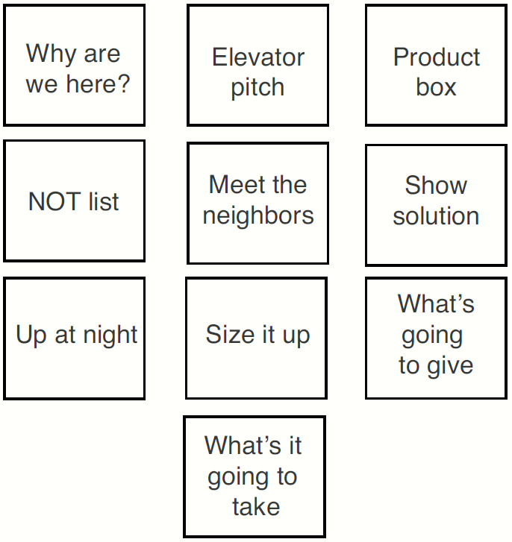
Inception Deck
10 questions to clarify
the big picture

Slide 20
What it looks like
http://agilewarrior.wordpress.com/2010/11/06/the-agile-inception-deck/

Slide 21
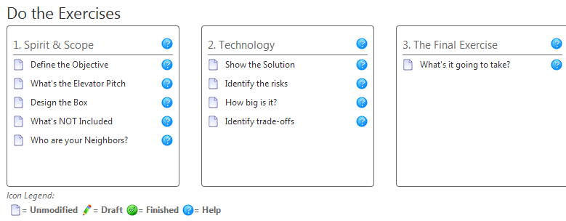
Resources
Starters:
  Inception Deck ppt template
    In class folder
  Online tool: https://www.myinceptiondeck.com/

Slide 22
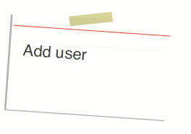
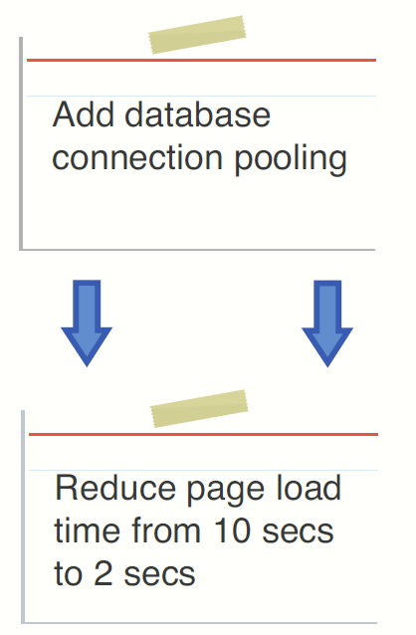
User Stories
Simple descriptions of desired functionality:
Write in terms of user goals:

Slide 23
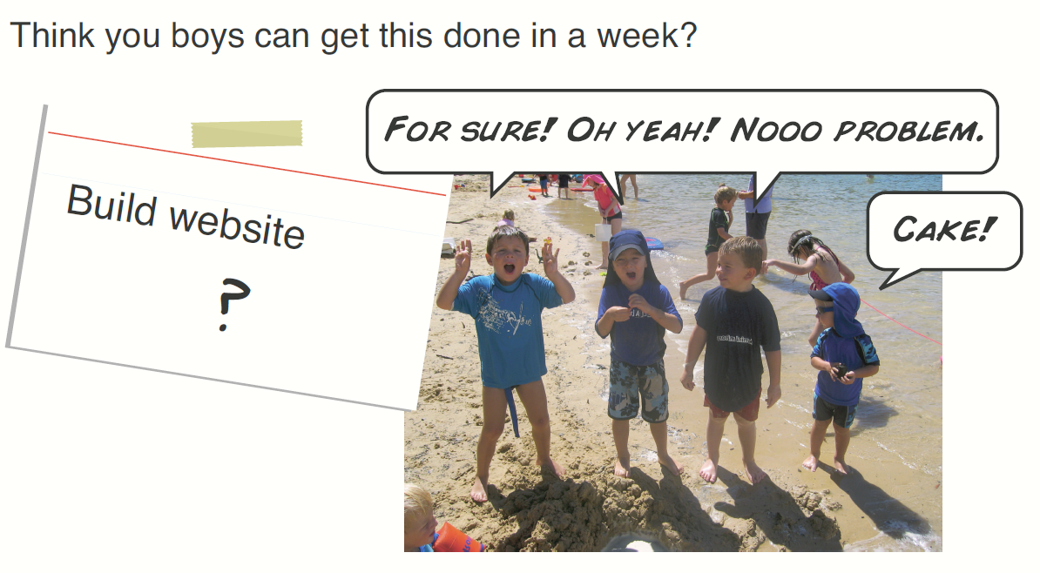
Story Size
Stories need to be small enough to make estimations about:

Slide 24
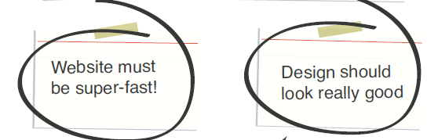
Constraints
Some things can not be expressed as actions
Maintain a list of constraints
  Verify against them frequently

Slide 25
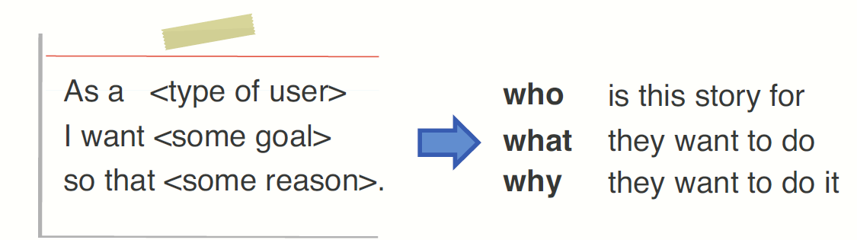
Template
Mad lib user story:

Slide 26
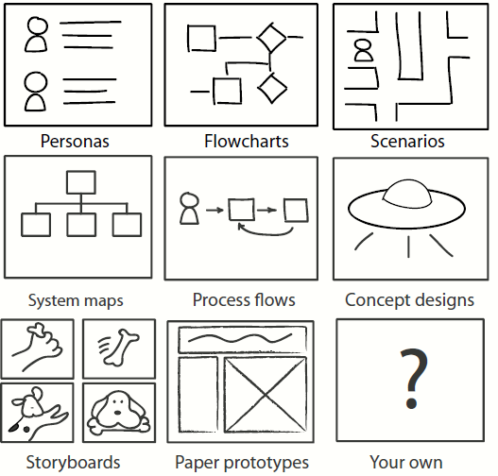
Don't work in a vacuum
Document thinking
Diagrams are still
important
Detailed specs are
not

Slide 27
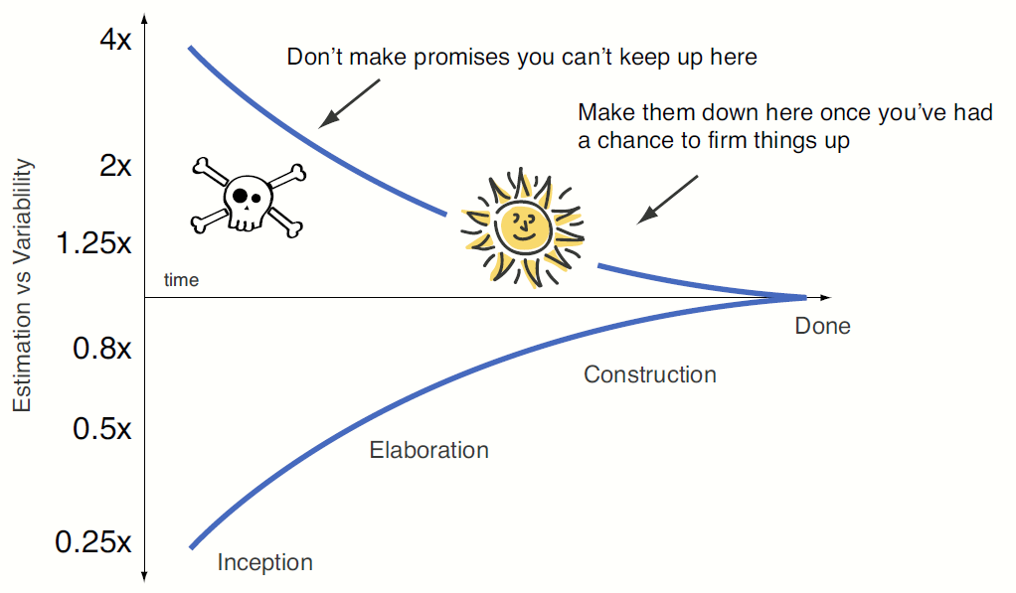
Estimation Issues
Hard to estimate exact times for things you haven't done
Even experienced coders working on familiar problems are overly optimistic

Slide 28
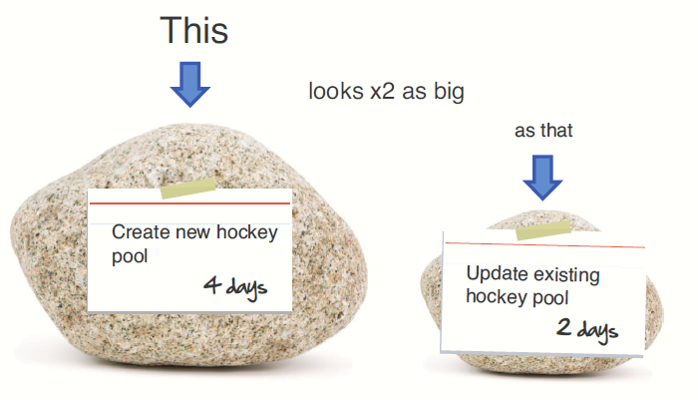
Relative vs Absolute Size
Much easier to compare things than come up with absolute numbers

Slide 29
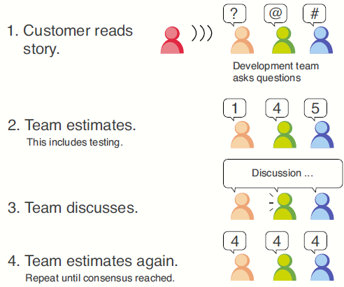
Planning Poker
Point assignment requires interaction

Slide 30
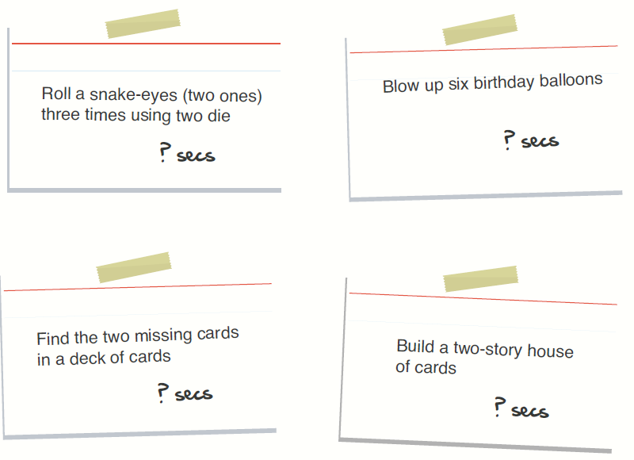
Points
Hard to think in hours/days
Estimate in relative size points
Sample:
  1 pt : easy
  2 pts : medium
  4 pts : very hard
  8 pts : too big, can't tell
Complex story strategies:
  Break down
  Spike – quick test

Slide 31
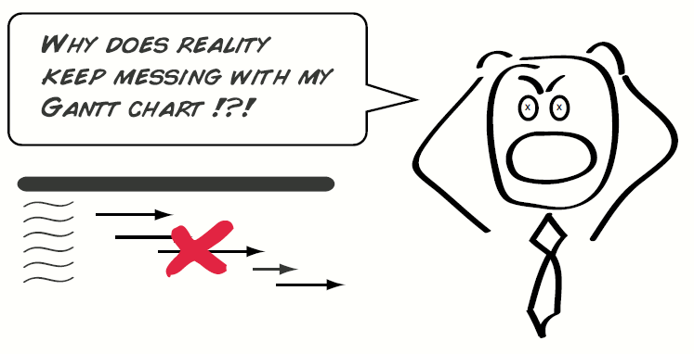
Estimation
Base estimations on recent past progress, not best guess predictions from 6 months ago

Slide 32
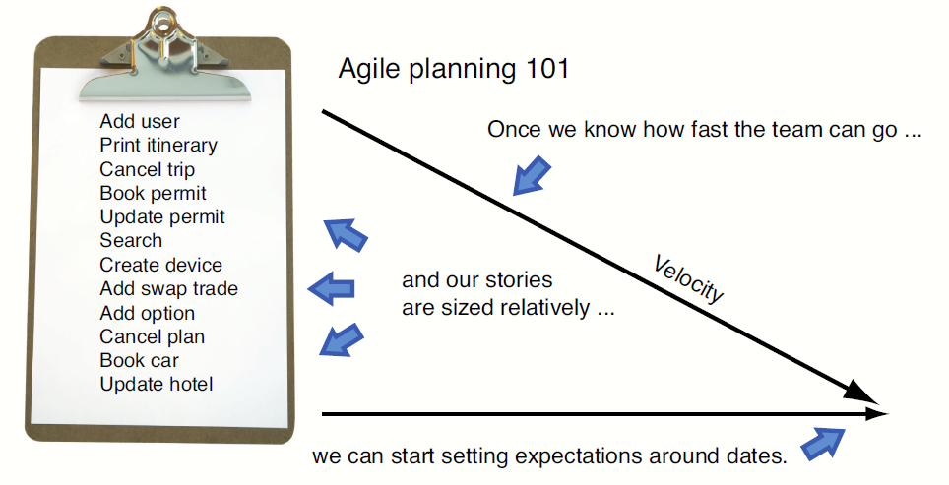
Velocity
Velocity = average pts per iteration
Used to estimate future progress

Slide 33
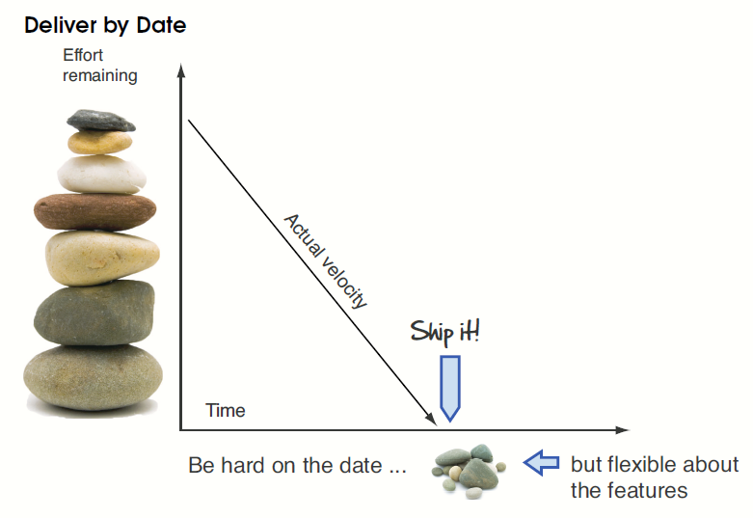
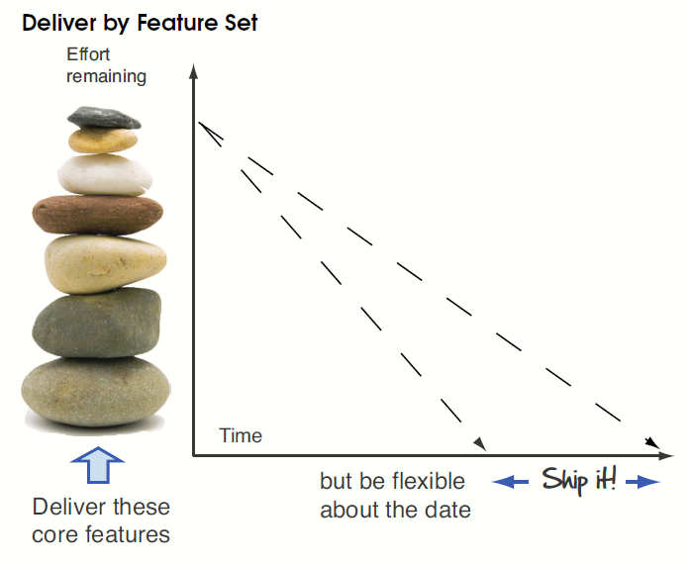
Flexibility
When reality won't cooperate:
  Reduce scope
  Increase time

Slide 34
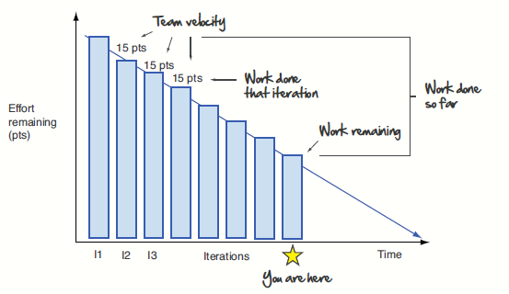
Burn Down Chart
Shows pts left to accomplish:

Slide 35
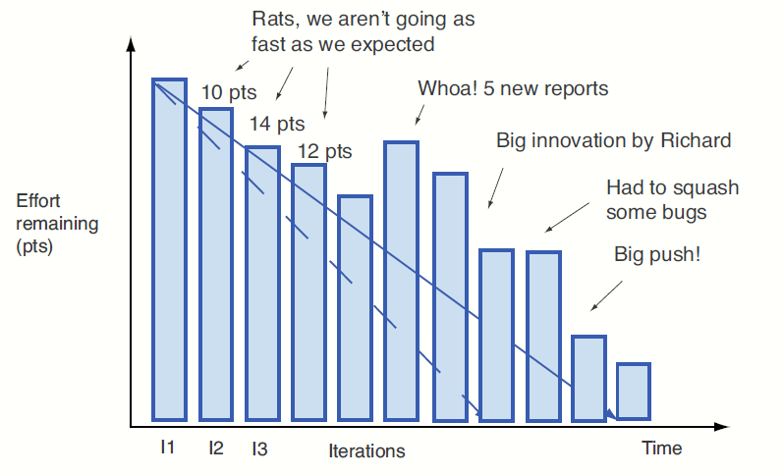
Burn Down Issues
New stories = negative progress

Slide 36
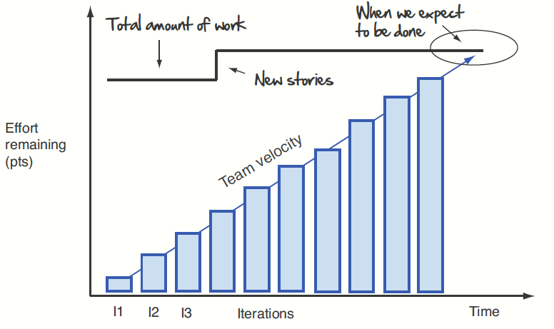
Burn Up Chart
Work up to ceiling (never go backwards)

Slide 37
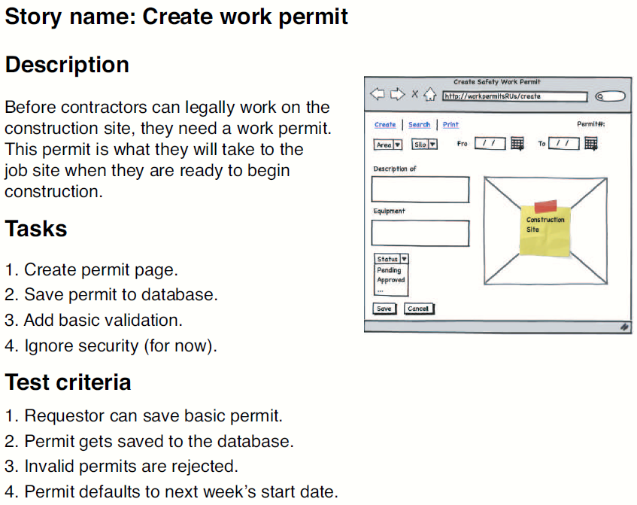
Fleshing out stories
Document stories as necessary
  Detail depends on needs of the team
Must have test
criteria

Slide 38
Testing
Testing an essential part of Agile
Unit tests : batch of tests to run against code
  Often coded before the code
  Cover every reasonable interaction with codebase
  Run each time changes are made
UI Testing

Slide 39
Meetings
Daily standup?
Every iteration do:
  Get feedback on last iteration’s stories
    Show value
    Get feedback
  Make sure next iteration’s work is ready
    Are the next iteration's stories ready to go?
  Plan the next iteration’s work
    Sign up for stories
    Evaluate health of project
  Continuously look for areas of improvement
    What is going well? Where are there problems?

Slide 40
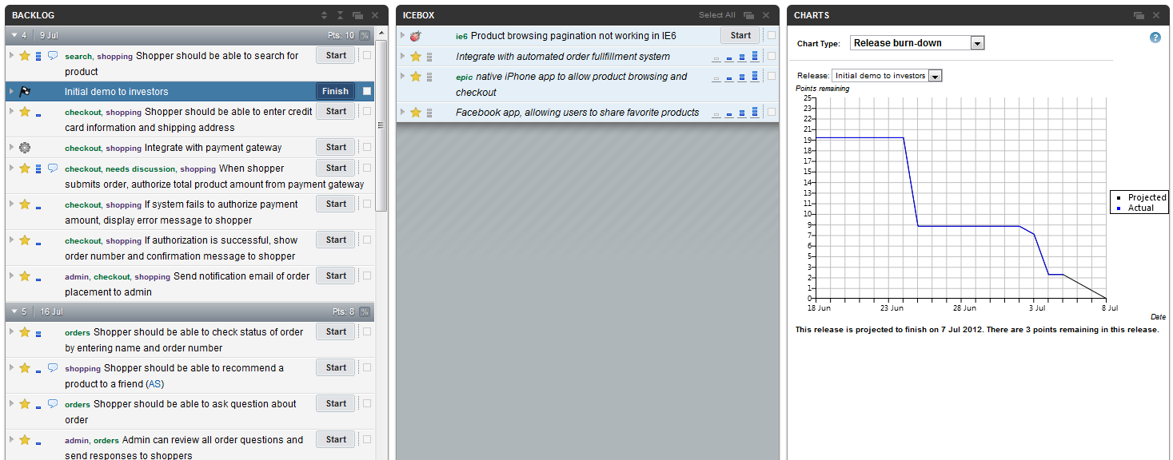
Management Tool
https://www.pivotaltracker.com/
  Agile oriented project tool
  Free for public projects

